Slide 1
Big Mountain Ski Resort

Slide 2
Problem Identifiation
Big Mountain Ski Resort located in Montana.
Currently charges $81 for a weekend ticket.
New chair lift increases operational costs by $1.5 million.
Investigate four scenarios to cut costs or increase revenue:
Closing 10 of the least used runs.
Adding a run, increasing vertical drop by 150 ft, and installing a new chair lift.
Same as Scenario 2, but adding 2 acres of snow making.
Increasing longest run by 0.2 miles and adding 4 acres of snow making.

Slide 3
Key Findings
Proceed with Scenario 2
Increase ticket price by $1.99
Would lead to an revenue increase of $3.5 million.
This covers the $1.5 million operational cost of new chair lift
Overall revenue increase of $2 million

Slide 4
Modelling
Data set contains over 300 ski resorts in the U.S.
Target feature: Adult Weekend Ticket Price
Random Forest Model built
For analysis, assumed 350,000 people visit Big Mountain a year and each visitor purchases 5 tickets.

Slide 5
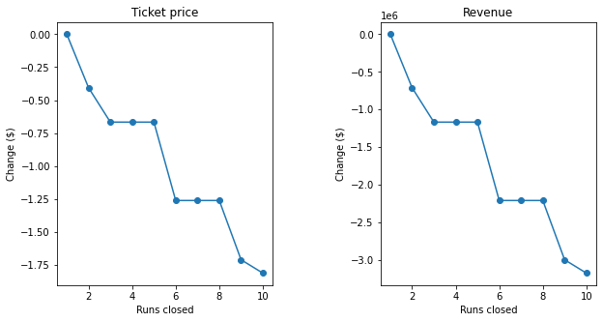
Scenario 1
Closing one run has no affect on ticket price.
Closing 10 runs would lead to over $3 million loss in revenue.

Slide 6
Scenario 2
Physical changes to resort:
Add a run
Increase vertical drop by 150 feet
Install additional chair lift
Suggest increase in ticket price from $81.00 to $82.99.
Generates $3.5 million in revenue.

Slide 7
Scenarios 3 and 4
Scenario 3: Same as scenario 2 + 2 acres of snow making
No change in ticket price
Scenario 4: Increase longest run by 0.2 miles + 4 acres of snow making
No change in ticket price

Slide 8
Summary
Resort can cover cost of new chair lift by increasing ticket prices to $82.99.
Would also need to add a run and increase vertical drop by 150 feet.
Expected total revenue is $2 million.

